Slide 1


Slide 2
A PRESENTATION ON
GROUTING SYSTEMS
FREEZING METHODS
SHAFT DRILLING AND BORING
SHAFT SINKING

Slide 3
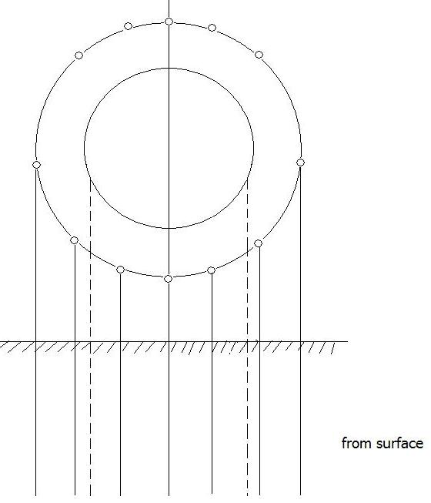
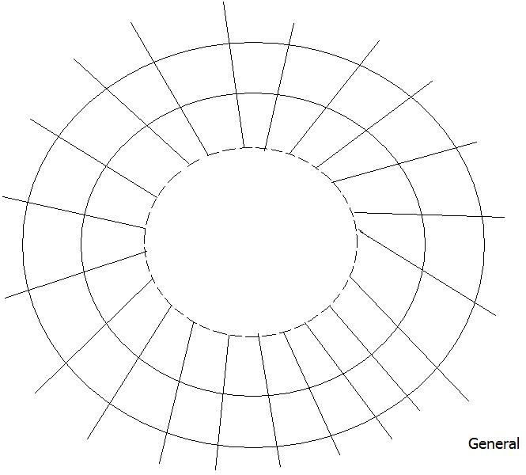
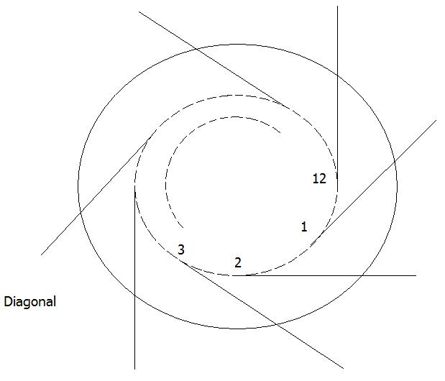
Grouting Systems
Applicability –1.Water bearing, competent but fractured rocks.
Sealed Zone is formed to arrest water reflow.
2.Voids also can be filled behind lining for improving lining ` tightness.

Slide 4
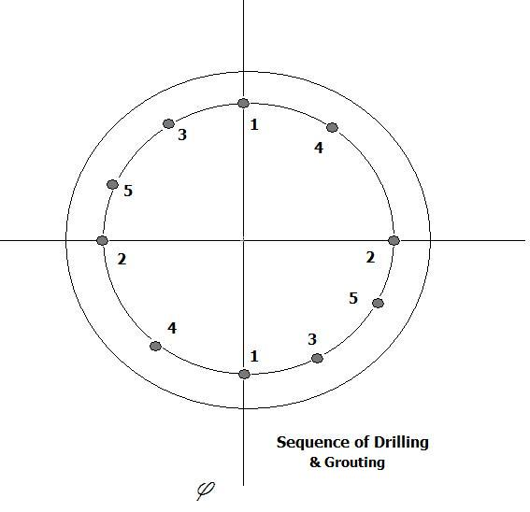
From surface
Hole specifications.
Diameter—3 to 5” or 75 to 150 mm
Radius—3 to 4m longer than the shaft radius
Distance between holes—2 to 4m
Entering of hole(3-5m)--- cement guiding like
Grouting length ---25 to 50 m
After 24 hrs. /redrilling in soft grout /extended.

Slide 5
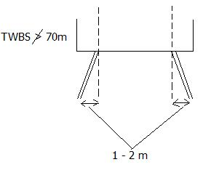
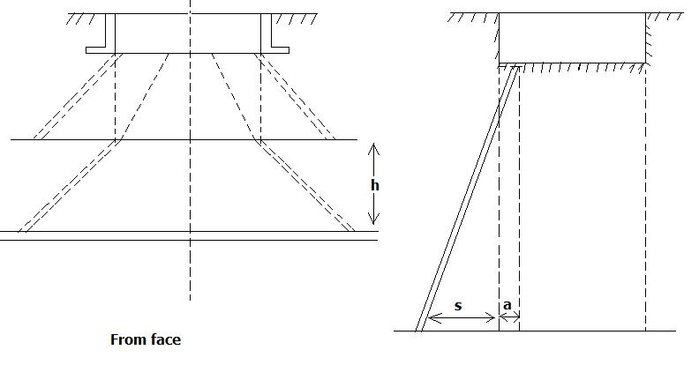
From Face
Section length ---12 to 25 m
When water bearing strata is below 100m.
Drilled in an angle ---1-2 away from front face.
Tangential fitting to cover longer area.
Hole spacing (0.8 to 1.5 m)
Size of hole (mm):
50-75 mm → initially
30-50 mm → finally
Size of hole (mm):
50-75 mm → initially
30-50 mm → finally
no. of holes ∞ 1. Rock character
2. Shaft diameter
3. Hydrological condition
Normally(10 to 20 to 30)

Slide 6
Sequence of grouting: -
First half are drilled & grouted. While these are getting hardened rest are drilled.
All are drilled & grouted one after the other starting with the hole with the largest inflow.
Pairs of holes are drilled & grouted & then perpendicular to these are drilled and grouted.
Selection of cement and grout parameters
Character of water(salt or fresh)
Mineralisation and chemical corrosives
Value of the titration factor
Density of grout ∞ water absorbability
Water absorbability, q = Q/(Hh)
Q: water volume (in litres / min).
H: water need
h: height of hole section (in m).

Slide 7
Large fractures: 25 to 30%
Small fractures: 3 to 5%
Optimum grouting regime has to be established first.
Cement : clay | 1 : 2
 | 1 : 3
 | 1 : 4
Cement : clay : sand | 1 : 1 : 15
 | 1 : 1 : 2

Slide 8
Equipment
Cementation pumps for grout injection.
Mechanical mixtures for grout preparation.
Grout tanks.
Flexible pressure hoses
Injectors
Pipes, valve pressure gauges, tools etc.
Pressure p= Hgk
H= depth from surface to top of strata
g= 1.5 to 2 t/m³
k = 2 to 3 (coefficient of cohesion of the strata above the grouting zone)
Normally ---1-3 MPa
Check ---water absorbability < 0.05 L/min/m
Grout consumption
SST ---- 3.3 to16.5 t/m.
Dolomite ---2.2 to 4.4 t/m
8 to 15 m/month (35 to 50 % more time)
30 to 50% more costly.
Excavation :
1 to 1.5 m long holes
Quantity of charge is reduced .
SST—1.3kg/cu.m. Shale:1.1 kg/m³ Coal:0.6 kg/m³

Slide 9
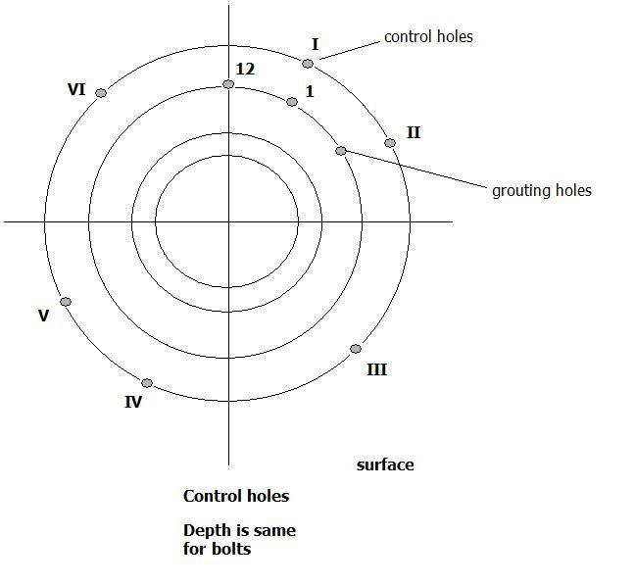
Testing of water presence is done and sinking proceeds .

Slide 10
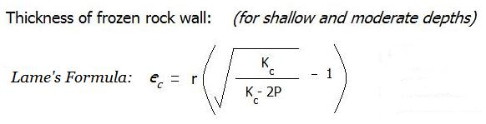
Freezing Method:
SUITABLE DESIGN PROCEDURE REQUIRES SOLN OF FOLLOWING PROBLEMS:
Calculation of the wall thickness of the frozen rock cylinder.
Diameter of the freezing circle, no., depth & spacing control holes.
Drilling system for freezing holes, specification of the equipment, freezing pipes diameter and freezing time.
Design of temporary shaft head with a freezing basement.
Planning of the freezing procedure in active & passive periods.
-freezing temperature, heat balance, ‘h’ of freezing installation, time.
System and time of Thawing.
Freezing tech planning, shaft sinking and lining.
Normally 5 to 5.5 metres.
In the above formula, we have:
P: MP_{C} (external pressure)
r: Shaft Radius
K_{C} : Allowable Stress

Slide 11
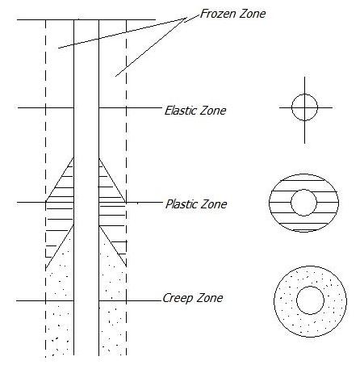
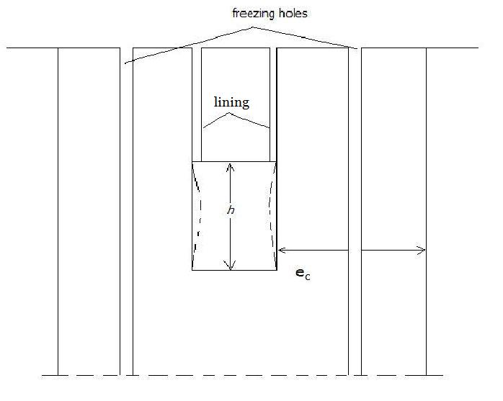

Slide 12
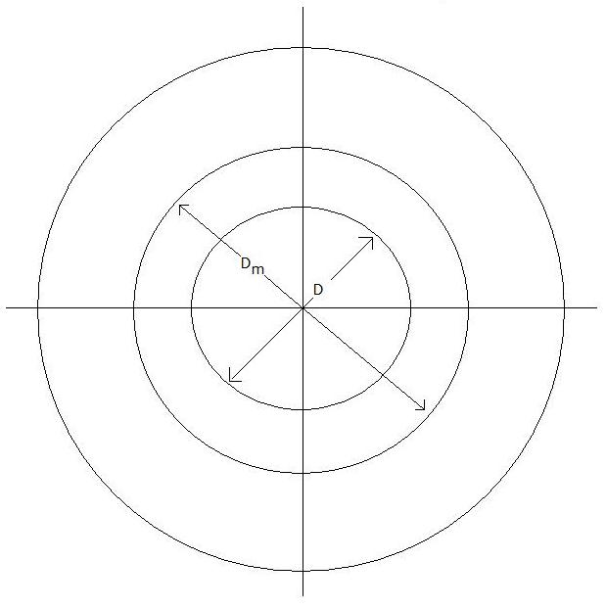

Freezing Holes
Thickness of frozen cylinder: 5 to 5.5 m.
(Where, H: Depth up to shaft bottom.)
D_{m} is larger by 2 m to the shaft. (80m)
D_{m} is larger by 2.5 m to the shaft. (150m)
D_{m} is larger by 3 m to the shaft. (>150m)

Slide 13
Distance between freezing holes – 0.9 to 1.1m. More 1.25 for deep.
The chord of overlapping circles should be equal to the calculated thickness of frozen wall.
Depth of holes → 5m below water bearing strata (55m).
Verticality of holes is the biggest problem.(Additional holes may be required)
2 to 3 rigs / mud fluid drilling medium /
Freezing hole equipment:
There are two columns of tubing –
Outside: 102 to 152m.
Inside : 32 to 51mm (steel) or (polyethylene)*
* Polyethylene has an advantage over steel because:
It has a lower weight.
It is cheaper.
It is easier to install.
It has a lower thermal conductivity.
Specific gravity is same as the brine.
We hence prefer polyethylene more over steel for the tubing purpose.

Slide 14
Process:
Freezing brine flows at high velocity down the inner pipe. It rises more slowly in the annulus absorbing heat from the surrounding rocks.
The type of flow is different depending on the region of flow. There are basically two flow regions:
1. Moderate depths → Laminar flow.
2. Deeper regions/clay/organic → Turbulent flow.
It needs 2 to 8 months time for freezing. The freezing in the moderate depths take place at round two months while those in the deeper regions take longer time up to 8 months.
Holes of larger diameter are needed for greater depths.
Complete tightness of joints among individual segments of pipes is necessary.
*Gases used and the temperature at which they are used to serve the purpose:
. Ammonia (NH₃):
(-)20º C – For one stage compression.
(-)40ºC – For double stage compression.
. Carbon Dioxide (CO₂): Used at (-)50ºC.

Slide 15
Periods:
Active: - 3 units min. full capacity till the desired frozen cylinder forms.
Passive: - Maintaining frozen rock mass at desired temperature during sinking & lining. 1/2 to 1/3 times the capacity is sufficient.
Heat Losses:
Heat from outside the frozen material.
Losses in freezing installation due to imperfect insulation.
Frost Penetration Velocity: -
The penetration occurs at the rate of: (i) 25mm per day in sand.
(ii) 10-15mm per day in clay.
On a larger scale, the penetration rate is: (i) 2-4 months per 250 metres of depth
(ii) 9-10 months per 500 metres of depth

Slide 16
EQUIPMENT FOR SHAFT SINKING
Site preparation
above HFL(100 years record)
Construction of roads and material storage areas
Grading of the terrain(while sinking also this can be done)
Water supply(drinking, industrial use and fire extinguishing)
80 - 120m³ / day 40 - 60m³ / day 80-100m³ / day
plant water tap water fire tank
( adequate ditch for storm water )
4. Electrical power supply(2 stages)
Preparatory - 260 KVA transformers - Diesel generator stand bye
Sinking - 1200 KVA, 500 V - Diesel generator stand bye
5. REQUIREMENTS:-
Storage space for material
Ramp for unloading heavy machinery
Telephone lines
Temperature buildings and head gear foundation
Installation of sinking equipment
Surveying of shaft elevation, centering

Slide 17
(B) Temporary Buildings
Office, first aid room, heating and cooling units, ware house
Lamp house(in accordance with MSHA standards)
Mechanical and blacksmith shop(for minor repair work)
Compressor sheds
Transformer station
Shed for concreting, mucking and other equipment
Shed for cement storage
Winch building for shaft stage
Fan housing
Flammable supplies ware house
Hoist Buildings
Storage for explosives(Magazine)
Accommodation for sinking crew.

Slide 18
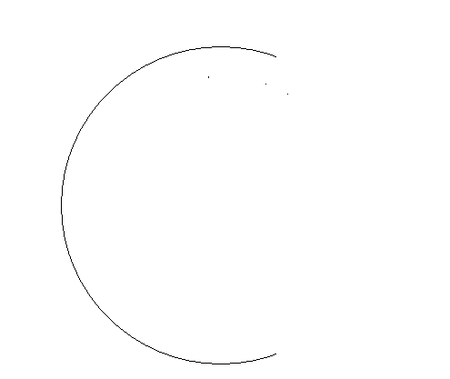
1) SHAFT COLLAR CONSTRUCTION(8-12m)
Air Channel
Channel for water pipes, air pipes
Ladder Compartment
Basement for pushers
D & B in Shafts : supposed to ensure-
Correct size and shape of planned excavation
Even shape of the surface
Uniform size of broken rock
Safe and economical operation
Mucking Shaft :- 50- 60% of cycle time
Mucking ‘η’
Depth

Slide 19
Muckers
Several type of muckers are in use depending on-
Shaft shape, size, depth and location
1. Scrapers- rectangular shafts
large dia shafts (U/G bunkers)
2. Overshot loaders on caterpillars
3. Cryderman Muckers
4. Cactus Grab (light)
5. Cactus Grab (heavy) Central Pivot (1.3cu)
Hanging from platform/hand guided
Attached to shaft wall(3)type
Large cap muckers for deep min/larger dia
- electric, pneumatic or hydraulic
Capacity:-
P_{t}= 3600 k V_{b} / t
where
P_{t} = Thermal Capacity in cubic meter per hour
k = Fill factor (0.8 to 0.9-sandstone
1.1 to 1.2-shale)
V_{b} = Bucket Capacity in cubic meter
t = mucking time
Lowering
Templing
Cleaning

Slide 20
DEWATERING OF SHAFTS
REQUIRED WHEN THERE IS:
Intersection of water courses
1. Changing water inflow
2. Changing pump head
3. Changing rock and mud contained water
4. Periodic changes in positioning of devices
WATER INFLOW into the shaft can be reduced by:
Pumping
Initial drainage / sealing / tapping

Slide 21
DEVICES FOR PUMPING
KIBBLES: Capacity:3cum/min
Depth- upto 150 m
Two types of kibbles- normal kibbles and special kibbles
Face pumps: based on compressed air principle
Centrifugal pumps
Reciprocating pumps- higher pumping head
-but they make a lot of noise
Multistage pumps: stationary pumps in convention with face pumps
uses stage pumping
Hanging pumps:-used to control large inflows
- pumping head of 200-400m

Slide 22
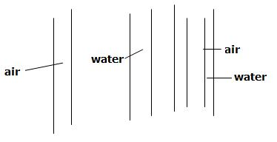
DEVICES FOR PUMPING
Intermediate pump: especially for deep shafts
Airlifts:-powered by compressed air
-most popular for small depths
Two main system for these pumps are:
parallel:- where the air pipe runs beside the water pipe
concentric:-where the air pipe is inside the water pipe
t. Pumps
Deep/ Stages/overflow chamber
3 combinaton

Slide 23
Equipment Nos.
Winders -400Kw-6600v 1 Main One Mineral
BB-3000
BB-2200-130kw-500v 1 Auxiliary One Man
Winder
Fans -6kw/500m³ 2
Air Compressors- 2
Winches Sufficient No.
Housing/Pumps
Shaft Fittings
(1)Burtons
(2)Ventilator Tubes (700mmø)
(3)Pipe Line for Concrete
(4)Compressed Air Tanks
(5)Steel Shutters
(6)Brackets
(7)Ropes for Winders
(8)Winches
(9)Hoisting Buckets (1.25m³/2 m³ )
(10)Grab
(11)Grab Loaders
(12)Drilling Machines
(13)Lighting Arrangement.
Pumping Accessories
Scaffolding
Shotcreting Equipment (mixer/nozzle/pipeline)
Exploder

Slide 24
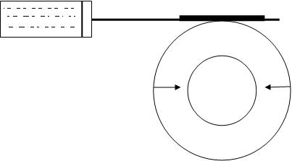
Purpose
1) Production 2) Service 3) Ventilation 4) Exploration
5) Escape 6) Combination
Brakes:
Holding of hoist drum
Electrical (mechanical breaking system )
(Normal/emergency operation)
Electric breaking
Regenerative energy returned to system / induction generator developer
Breaking torque
3. Counter torque
4. Dynamic
Mechanical breaking
1. To slow down the drum
2. Holds the drum at rest
Jaw /parallel motion /disk brakes –friction hoists
Drum /friction hoists
Calliper brakes
1. Speed /force of breaks
2. Controlled by oil flow

Slide 25
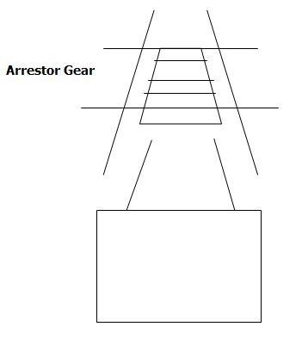
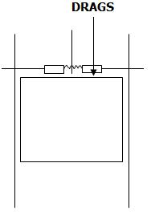
Drum hoist
1. Over wind /rope breakage
2. Safety dog
Friction hoist
Over wind: Arrestor Gear

Slide 26
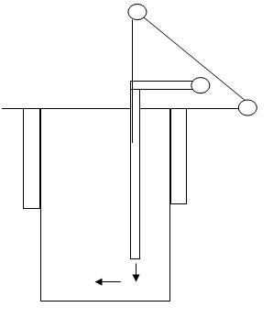
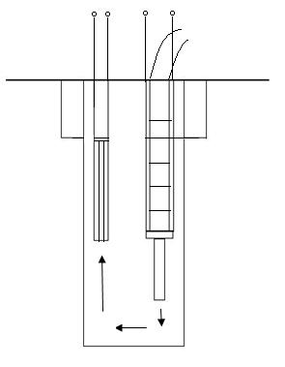
Ventilation
Ducting is hung in the shaft by two steel ropes connected periodically to collars round the pipe.
Lights
-safety
-output
-flood light charters
-suspended stage and tensor frame special reflector and sealed cover
-hang on ropes(special cable)
-100W lamps and even 40-50m of water.

Slide 27
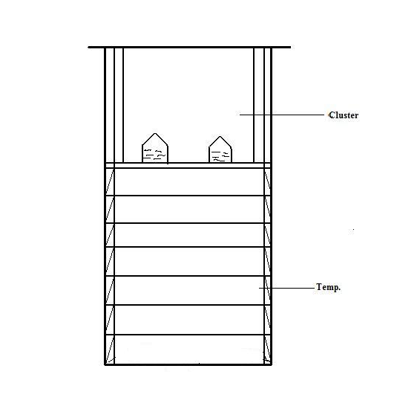

Slide 28
SHAFT DRILLING AND BORING
Boring of shafts/large diameter holes/ foundation of off-shore drilling.
Shaft sinking is slow, tedious, hazardous and uncomfortable.
Drilling is possible up to depths 1000m.
Diameter - 10m
Weak and moderate - Strength rock (300MPC)
Cope with difficult hydro geological conditions.
STEPS IN DESIGNING
Geotechnical and hydro geological parameters.
Planned shaft diameter, depth, adequate cutters for the type of rock, stages of reams and properties of drilling fluid.
Design of shaft head.
Living placement methodology/sealing.
Sealing of water.
Organization of the drilling site, location of ponds, storage of living components.
DRILLING FLUID
Water and natural clay / SG - 1.15 to 1.25

Slide 29
DRILLING EQUIPMENT
Drilling equipment consists of Heavy drill rigs having sufficient capacity to provide the required torque and the hoisting capacity.
Ex: - CSD 300 (Hughes Micon)
6 Hydraulic motors, 70 KNm Torque
Shaft Alignment is 1 in 1000
CUTTERS
Milled steel tooth cutters - Soft rock
Tungsten carbide cutters - harder rock (abrasive)
Disk cutters - not needed for (blind hole drilling)
LINING
200mm/ Shot Crete / Bolts / Wire mesh/ concrete/prepared and placed.

Slide 30
SHAFT BORING
New / least matured (1960’s)
SBM’s (vertical TBM’s)(personnel travel log inboard)
Picking up the cutting is the major problem.
Wirth m/c - successful with pilot hole for free much removal to a lower face.
Blind shafts were driven with limited success only.
SBM’s (2cutter motors of 261 KW / disc cutters)
Carboniferous rock is the most suited one.
Grouting of water bearing strata is mandatory before shaft boring.
SHAFT RAISING
Raise boring m/c’s in place of conventional methods are common today
Raise climbers
Lower level is developed
When sinking is not possible due to lack of space or lack of room for production
Only on competent rocks
Without water inflow

Slide 31
ADVANTAGES
Influence on mine performance is minimum
Loading of muck into buckets is avoided
Blasting efficiency is greater
No water pumping is required
DISADVANTAGES
Height of rising limited (100 to 120m)
Ladder climbing inconvenient for men and material transport.
Potential hazard of pieces of rock falling from face
Potential threat of much jamming on chute
Surveying is difficult
Time and cost for preparing the opening for raising purpose.

Slide 32
EQUIPMENT
Chute
Hoist
Ladder
Brattice
Heavy load bearing wooden platform with steel girders
F.O.S - 6
Face to platform 1.5m-3.0m, 5m(at a go) (in strong rocks)
Ventilation through a (200 - 300m) diameter hole drilled above.
ALTERNATIVES (3)
Raising the diameter up to 4m(Temperature/permanent)
Permanent lining is done at every short interval.
Diameter > 4m. Pilot hole is then widened.

Slide 33
MECHANICAL RAISE CLIMBERS:
For hard rock (Alimah- Swedish)
Runs on a guide rail (Pin rock) (through rock bolts)
ADVANTAGES:
Permits the driving of very long raises, vertical or inclined, straight or curved.
When travelling to the head of the raise, personnel are well protected in a cage under the platform.
Miners work on a platform whose height/angles can be adjusted.
Risks of gases are reduced(through ventilation)
All the material can be transported easily.
Timbering avoided / rock bolting and mesh may be used.
Usable up to 8m² area.
DISADVANTAGES:
Cost for short stretches not justified.

Slide 34
THANK YOU

